Slide 1
Data Table & File Operations in
UIPath RPA

Slide 2
Introduction to Data Tables
What is a Data Table?
A Data Table in RPA, particularly in UiPath, is a powerful in-
memory representation of structured data.
It organizes information in a tabular format, similar to a
spreadsheet or database table, comprising rows and columns.
Key Characteristics &
Components
This structure allows for the eﬃcient storage, manipulation, and
processing of data sets within automation workﬂows without
keeping source ﬁles (like Excel) open.
STRUCTURED FORMAT
DYNAMIC & FLEXIBLE
Data is organized into
rows (DataRow) and
columns (DataColumn),
ensuring consistency
and relational integrity.
Can be created,
Why are Data Tables Crucial in
RPA?
modiﬁed, and processed
in real-time during
automation execution,
adapting to workﬂow
needs.
They are fundamental for handling large volumes of dynamic or
extracted information, acting as a universal container for
structured data.
DATA TYPE AWARE
HEADERS & INDEXES
Data Tables provide a standardized way to interact with diverse
data sources, such as Excel sheets, databases, web tables, and API
responses.
Each column can
enforce a speciﬁc data
type (e.g., String,
Integer, Boolean,
DateTime), ensuring
data quality.
Columns have unique
headers and both
rows/columns are zero-
indexed, allowing for
easy and direct access.
Their crucial role lies in enabling sophisticated data
manipulation, transformation, and integration, forming the
backbone of complex data-driven automation.
Common Data Table Operations
Building & Populating: Creating new tables and
adding data rows.
Filtering & Sorting: Selecting speciﬁc rows based
on criteria and ordering data.
Joining & Merging: Combining data from two or
more tables.
Iteration: Looping through each row using 'For
Each Row in Data Table'.
Manipulation: Adding, removing, or updating
columns and rows.

Slide 3
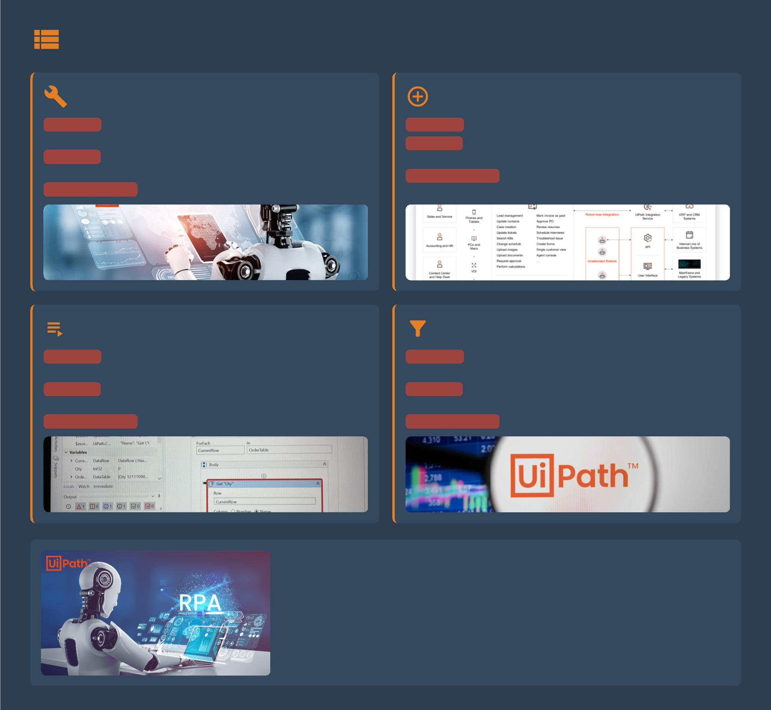
Common Data Table Activities
Build Data Table
Add Data Row
Purpose: Initializes an empty data table structure with deﬁned
Purpose: Appends new rows of data to an existing data table.
columns.
Key Use: Populating tables from sources like scraped data or
Key Use: A starting point for creating dynamic data sets within
variables.
an automation.
UiPath Activity: `Add Data Row` Activity.
UiPath Activity: `Build Data Table` Activity.
Reading Data (For Each Row)
Filtering Data
Purpose: Iterates through each row of a table to access
Purpose: Selects a subset of rows from a data table based on
individual entries.
criteria.
Key Use: Performing operations on each record, like validation or
Key Use: Extracting relevant info and isolating records based on
transformation.
business rules.
UiPath Activity: `For Each Row in Data Table` Activity.
UiPath Activity: `Filter Data Table` Activity.
Typical Data Table Workﬂow
Data tables are integral to RPA. A common workﬂow involves:
> Acquisition: Extracting data from Excel, web, or databases.
> Preparation: Using Build Data Table and Add Data Rows.
> Processing: Iterating with For Each Row or selecting with Filter Data Table.
> Output: Writing processed data to new ﬁles or systems.

Slide 4
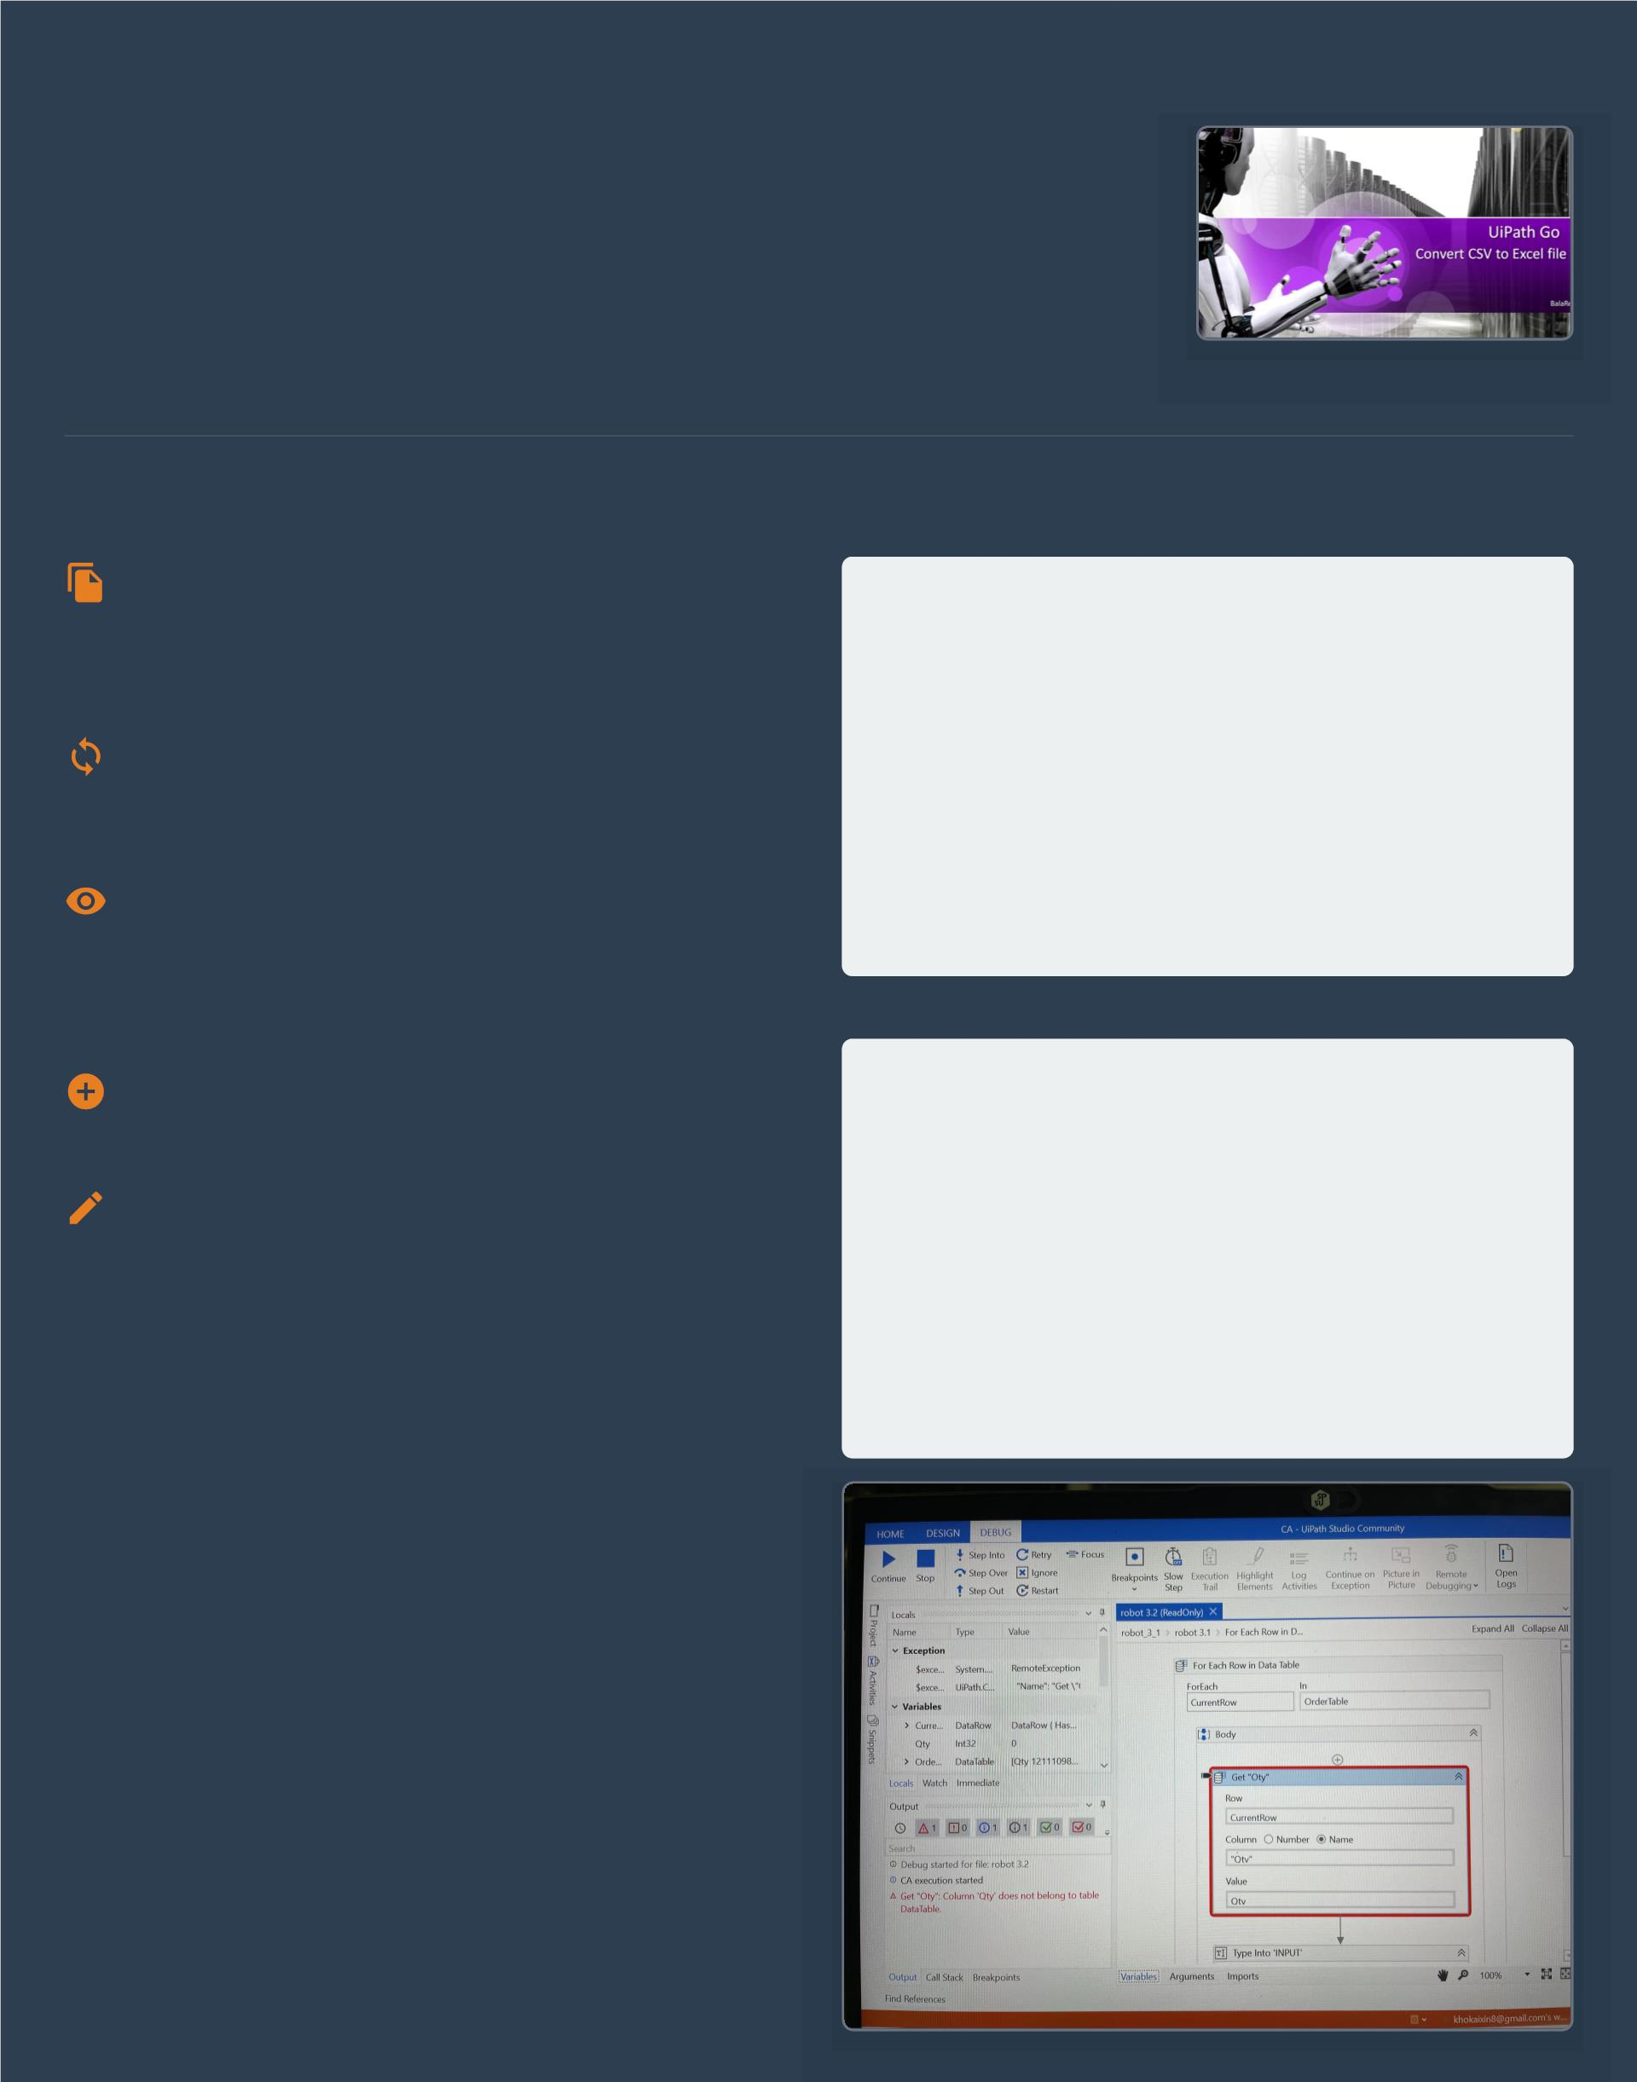
Data Table Usage Example: Employee Records
Scenario: Automating Employee Information Processing
from CSV
A common business challenge involves processing new or updated employee data from a CSV
ﬁle. Manually handling these records is ineﬃcient and prone to errors.
UiPath, leveraging Data Tables, oﬀers a robust solution for automating this process. This
example outlines a workﬂow to read employee information, display it, and then perform data
enrichment.
Step-by-Step Workﬂow: Reading &
Displaying Data
Conceptual Employee Data Table
Initial data loaded from CSV:
1. Read CSV File
| Employee ID | Name
| Department | Salary
Utilize the Read CSVactivity to import the structured employee
data directly into a UiPath Data Table variable. This activity
eﬃciently parses the CSV content, automatically creating columns
and rows.
|
|-------------|-------------|------------|--------
--|
| 1001
| Alice Smith | HR
| Bob Johnson | IT
| Carol White | Sales
| 60,000
| 75,000
| 65,000
| ...
2. Process Data with Loop
|
Employ the For Each Row in Data Tableactivity. This crucial
step iterates through each individual employee record, allowing
for granular processing of each entry.
| 1002
|
| 1003
3. Display Information
|
| ...
|
| ...
| ...
Within the loop, use activities like Write Line(for console output)
or Message Boxto showcase selected employee details.
Data Manipulation: Adding a 'Bonus' Column
Data table after manipulation (Bonus column added and populated):
1. Add New Data Column
| Employee ID | Name
| Bonus |
| Department | Salary
Use the Add Data Columnactivity to introduce a new column, for
instance, 'Bonus', to the existing Data Table.
|-------------|-------------|------------|--------
--|---------|
2. Populate New Column Values
| 1001
| Alice Smith | HR
| Bob Johnson | IT
| Carol White | Sales
| 60,000
| 75,000
| 65,000
| ...
Iterate through the Data Table again. For each employee,
calculate their bonus and assign this value to the new 'Bonus'
column for that speciﬁc row.
| 6,000 |
| 1002
| 7,500 |
| 1003
| 6,500 |
| ...
| ...
| ...
| ...
|

Slide 5
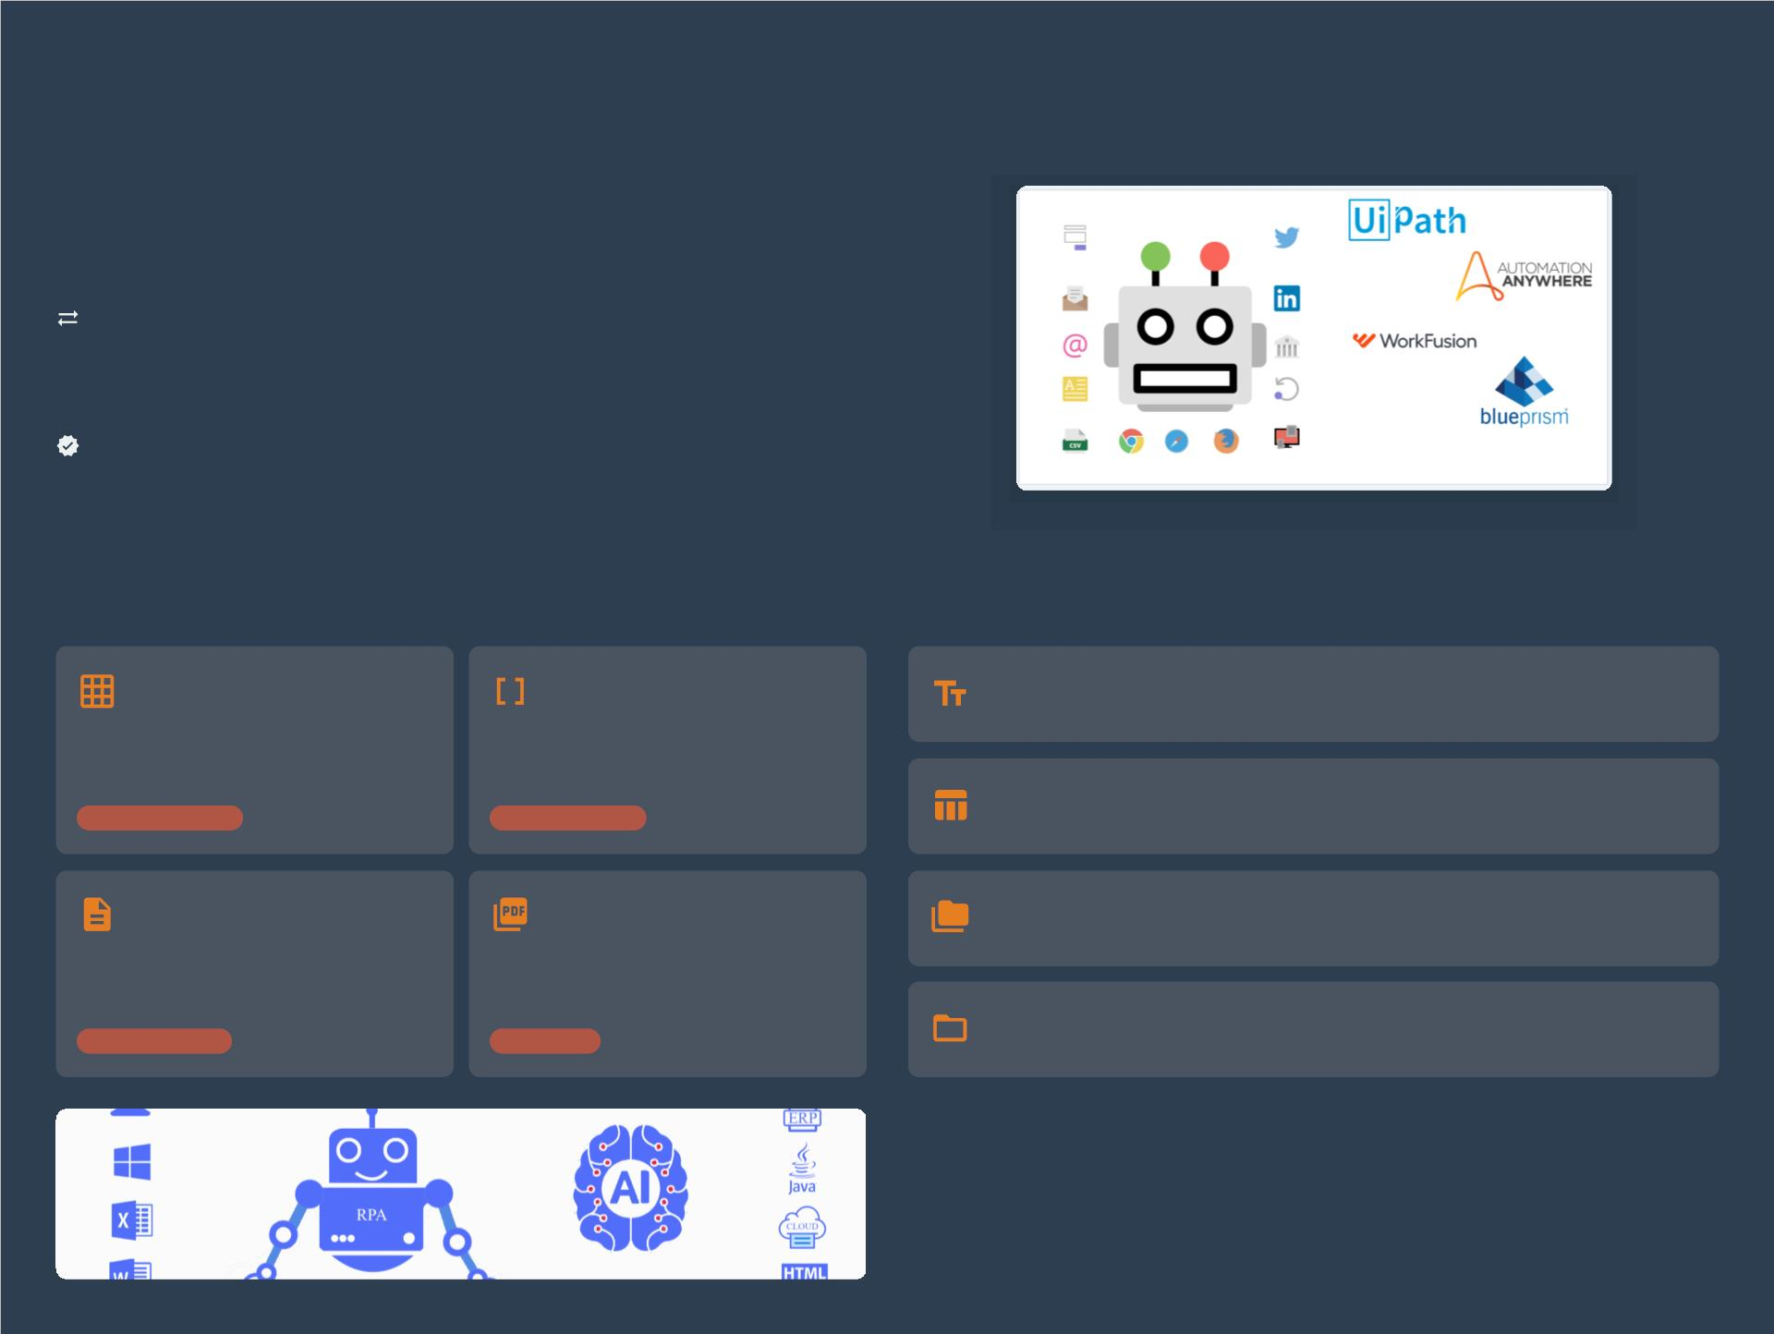
Introduction to File Operations
The Crucial Role of File Handling in RPA
In Robotic Process Automation (RPA), bots frequently interact with various
ﬁle types to perform core business processes. Eﬀective ﬁle handling is
paramount for seamless automation.
Data Exchange and Persistence: Files serve as primary conduits for
exchanging data between systems (e.g., exporting data via CSV, or processing
incoming invoices in PDF format). They also ensure information is stored and
accessible across workﬂow stages.
Workﬂow Integration and Compliance: Automation often involves reading
conﬁgurations from text ﬁles or archiving reports as PDFs. Robust ﬁle operations
ensure data integrity, facilitate audit trails, and manage document lifecycles for
compliance.
Key File Types & Their Relevance
Essential UiPath File Activities
Excel (.xlsx)
CSV (.csv)
Read/Write Text File
Read content from or write data to simple .txt ﬁles.
Ubiquitous for structured data, reports, and
calculations. UiPath has extensive activities
for manipulation.
Lightweight, delimited text ﬁles ideal for
bulk data import/export between diﬀerent
systems.
Read/Write CSV
Structured Data
Data Exchange
Read/write structured data between CSV ﬁles and DataTables.
Text (.txt)
PDF (.pdf)
File Management
Core actions: Copy, Move, Delete, and Path Exists checks.
Used for logs, conﬁguration ﬁles, and
simple unstructured data. Easy to read,
write, and append.
For invoices, reports, and oﬃcial
documents. Bots can read text or use OCR
for scanned versions.
Folder Management
Logs & Conﬁgs
Reporting
Activities to Create, Delete, and Enumerate ﬁles in folders.

Slide 6
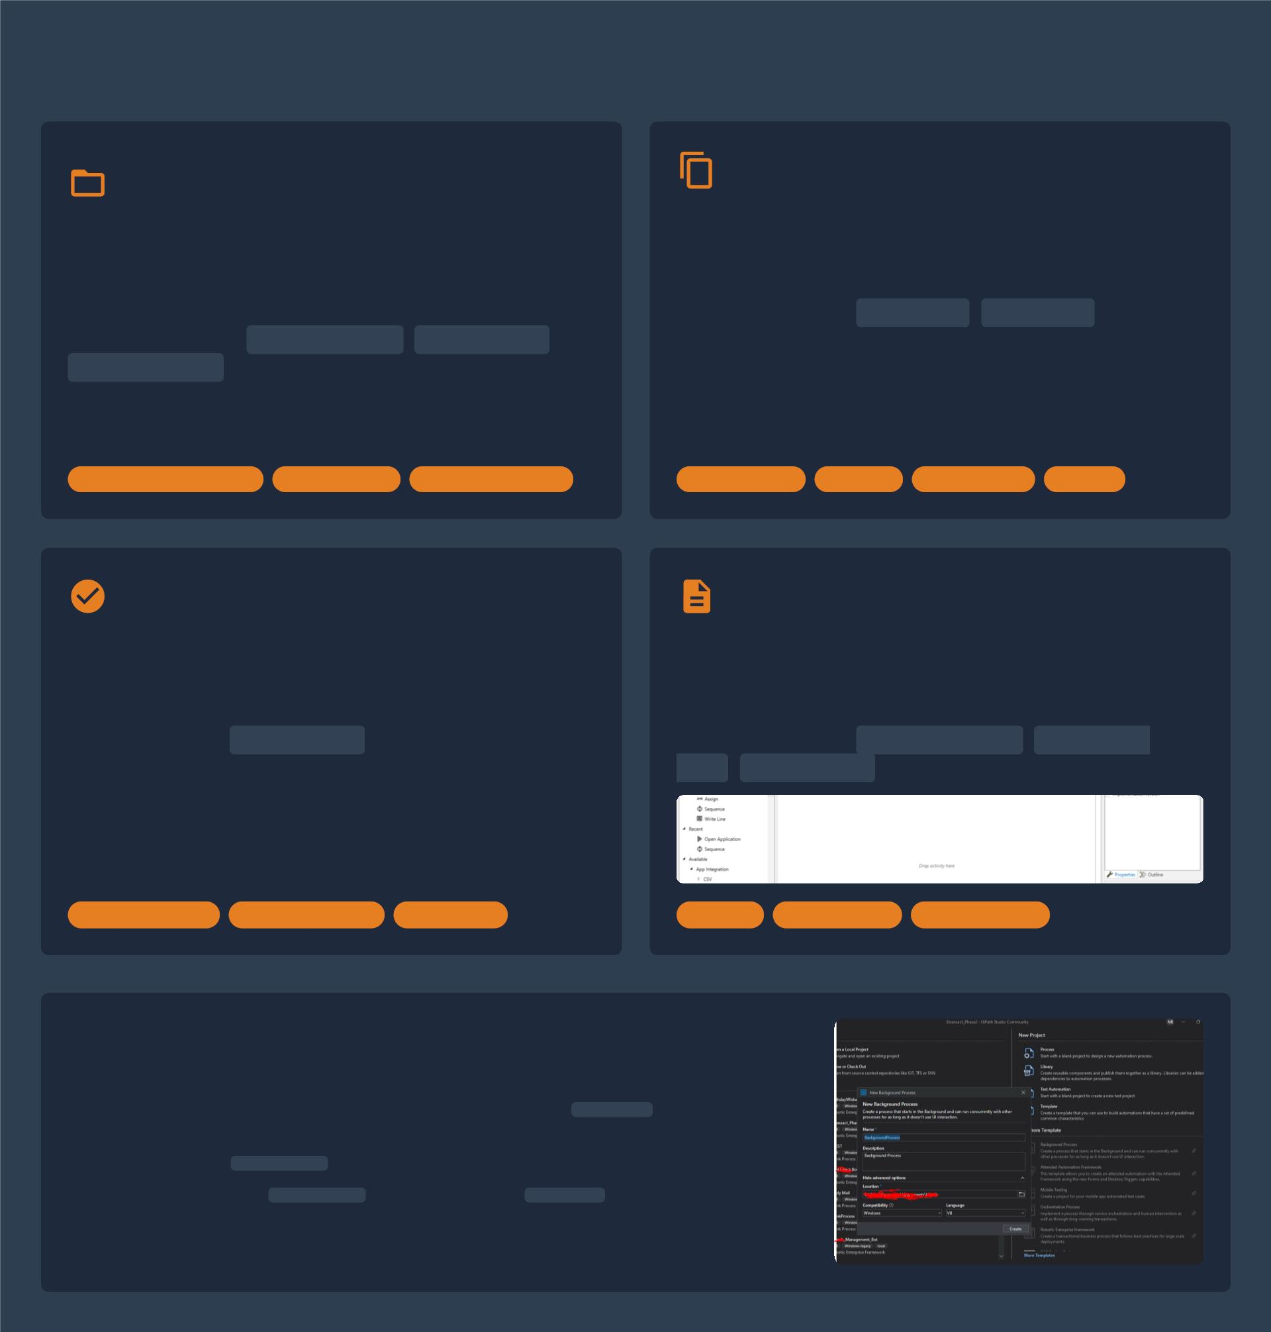
Essential File Manipulation Activities
Creating & Deleting
Files/Folders
Moving & Copying Files
Purpose: Facilitating data transfer and organization.
Crucial for managing data ﬂow, backups, and archival
processes.
Purpose: Automating the lifecycle of ﬁles and directories.
Fundamental for setting up environments, handling temp
data, and ensuring data hygiene.
UiPath Activities: Copy File , Move File .
UiPath Activities: Create Folder , Delete File ,
Use Cases: Archiving processed documents, distributing
Delete Folder .
reports to network shares, creating secure backups.
Use Cases: Setting up project output directories, clearing
temporary folders, managing structured archives.
Lifecycle Management
Data Hygiene
Automation Setup
Data Transfer
Archival
Organization
Backup
Checking File Existence
Reading & Writing Text Files
Purpose: Verifying the presence of a ﬁle or folder before
acting on it. Critical for building robust, error-resistant
workﬂows via conditional logic.
Purpose: Interacting with plain text for managing
conﬁgurations, logging information, or simple data
exchange.
UiPath Activity:
Path Exists
returns a boolean to
UiPath Activities:
,
Read Text File Write Text
drive If/Else conditions.
,
.
File Append Line
Use Cases: Ensuring input ﬁles are available, preventing
accidental overwrites, executing alternative logic if a ﬁle is
missing.
Error Prevention
Conditional Logic
Robustness
Logging
Conﬁguration
Data Exchange
Common File Manipulation Scenarios in RPA
Report Generation: Bots generate reports (CSV, TXT) and use Move File to place them in
designated shares.
Log Management: Append Line maintains detailed activity logs for monitoring and auditing.
Dynamic I/O Handling: Path Exists veriﬁes inputs, and Move File sorts outputs to
'Processed' or 'Error' folders.

Slide 7
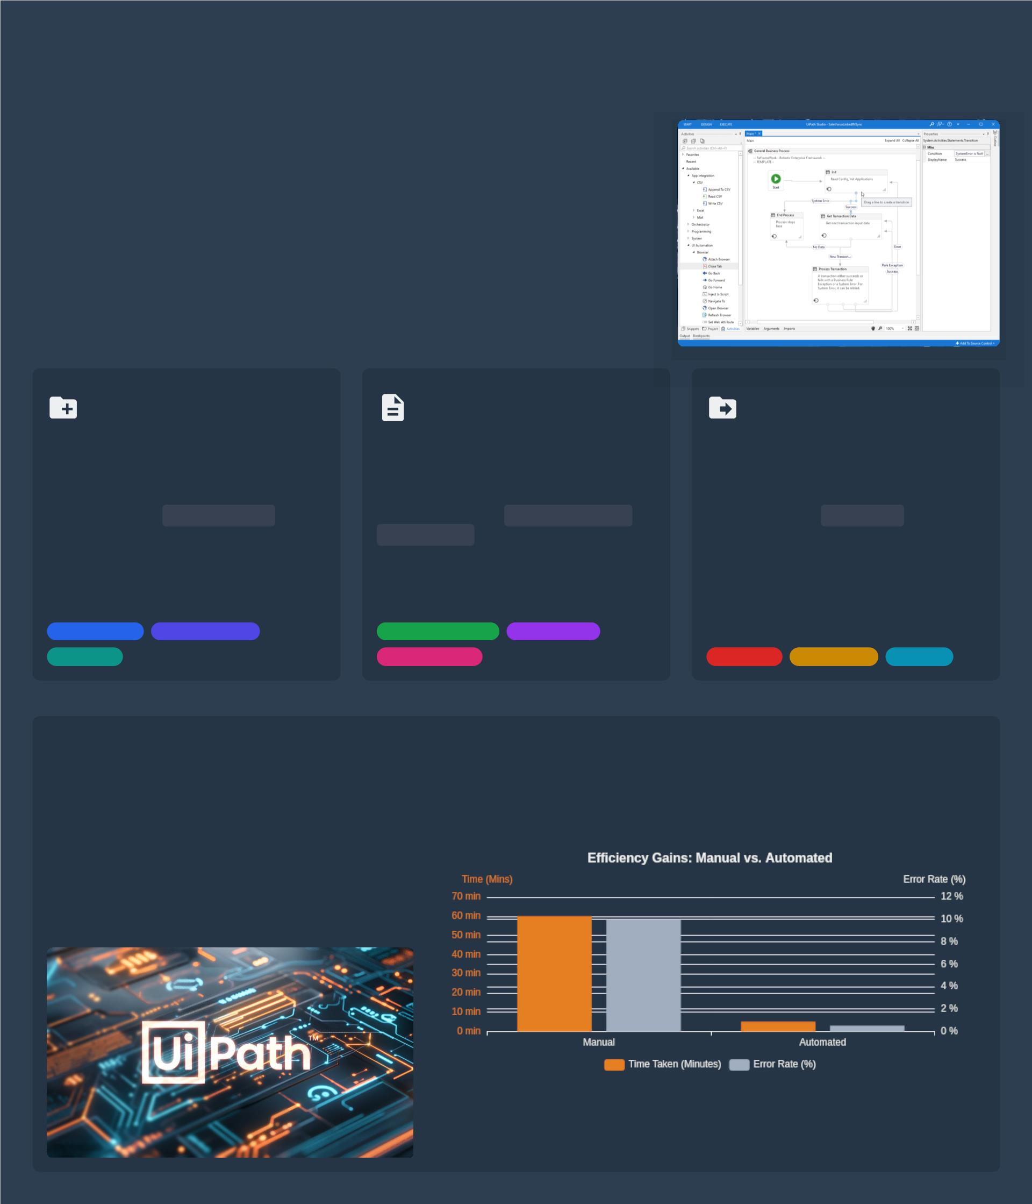
Step-by-Step File Operation Example: Report
Generation
Scenario: Automating Daily Report Creation &
Population
Automating the creation and population of daily reports is a classic application of
RPA. This process often involves gathering data, formatting it, and distributing the
ﬁnal report. Manual execution is repetitive, time-consuming, and prone to human
error.
UiPath ﬁle operations streamline this by allowing bots to dynamically manage
folders, generate reports with real-time data, and eﬃciently archive them, ensuring
consistency and accuracy.
1. Creating a New
Report Folder
2. Generating a
Dynamic File
3. Moving File to
Archive
Purpose: Establish a dedicated, date-
stamped directory for each day's reports
for organized storage.
Purpose: Create the report ﬁle (e.g., .txt or
.csv) populated with processed data from
the workﬂow.
Purpose: Move the report to a long-term
archive for historical data retention and
compliance.
UiPath Activity: Create Folder
UiPath Activities: Write Text File or
UiPath Activity: Move File
Example: Robot creates a folder like
Append Line .
Example: Move the report to
Reports\Daily_Report_2023-10-27.
Example: Write a summary to
...Sales_Overview.txt with today's sales
ﬁgures.
Archive\Reports\2023\October\.
Rationale: Use Path Exists to prevent errors
if the folder already exists.
Rationale: Ensures proper data lifecycle
management and clears the working
directory.
Organization
Structure
Date-stamping
Dynamic Content
Customization
Data Output
Archiving
Compliance
Cleanup
Impact & Beneﬁts of Automated Report Generation
Automating daily report generation signiﬁcantly
boosts eﬃciency and accuracy, transforming a
manual burden into a seamless, reliable process.
This approach frees up human resources for more
strategic tasks, eliminates human-induced errors,
and ensures timely availability of critical business
insights.

Slide 8
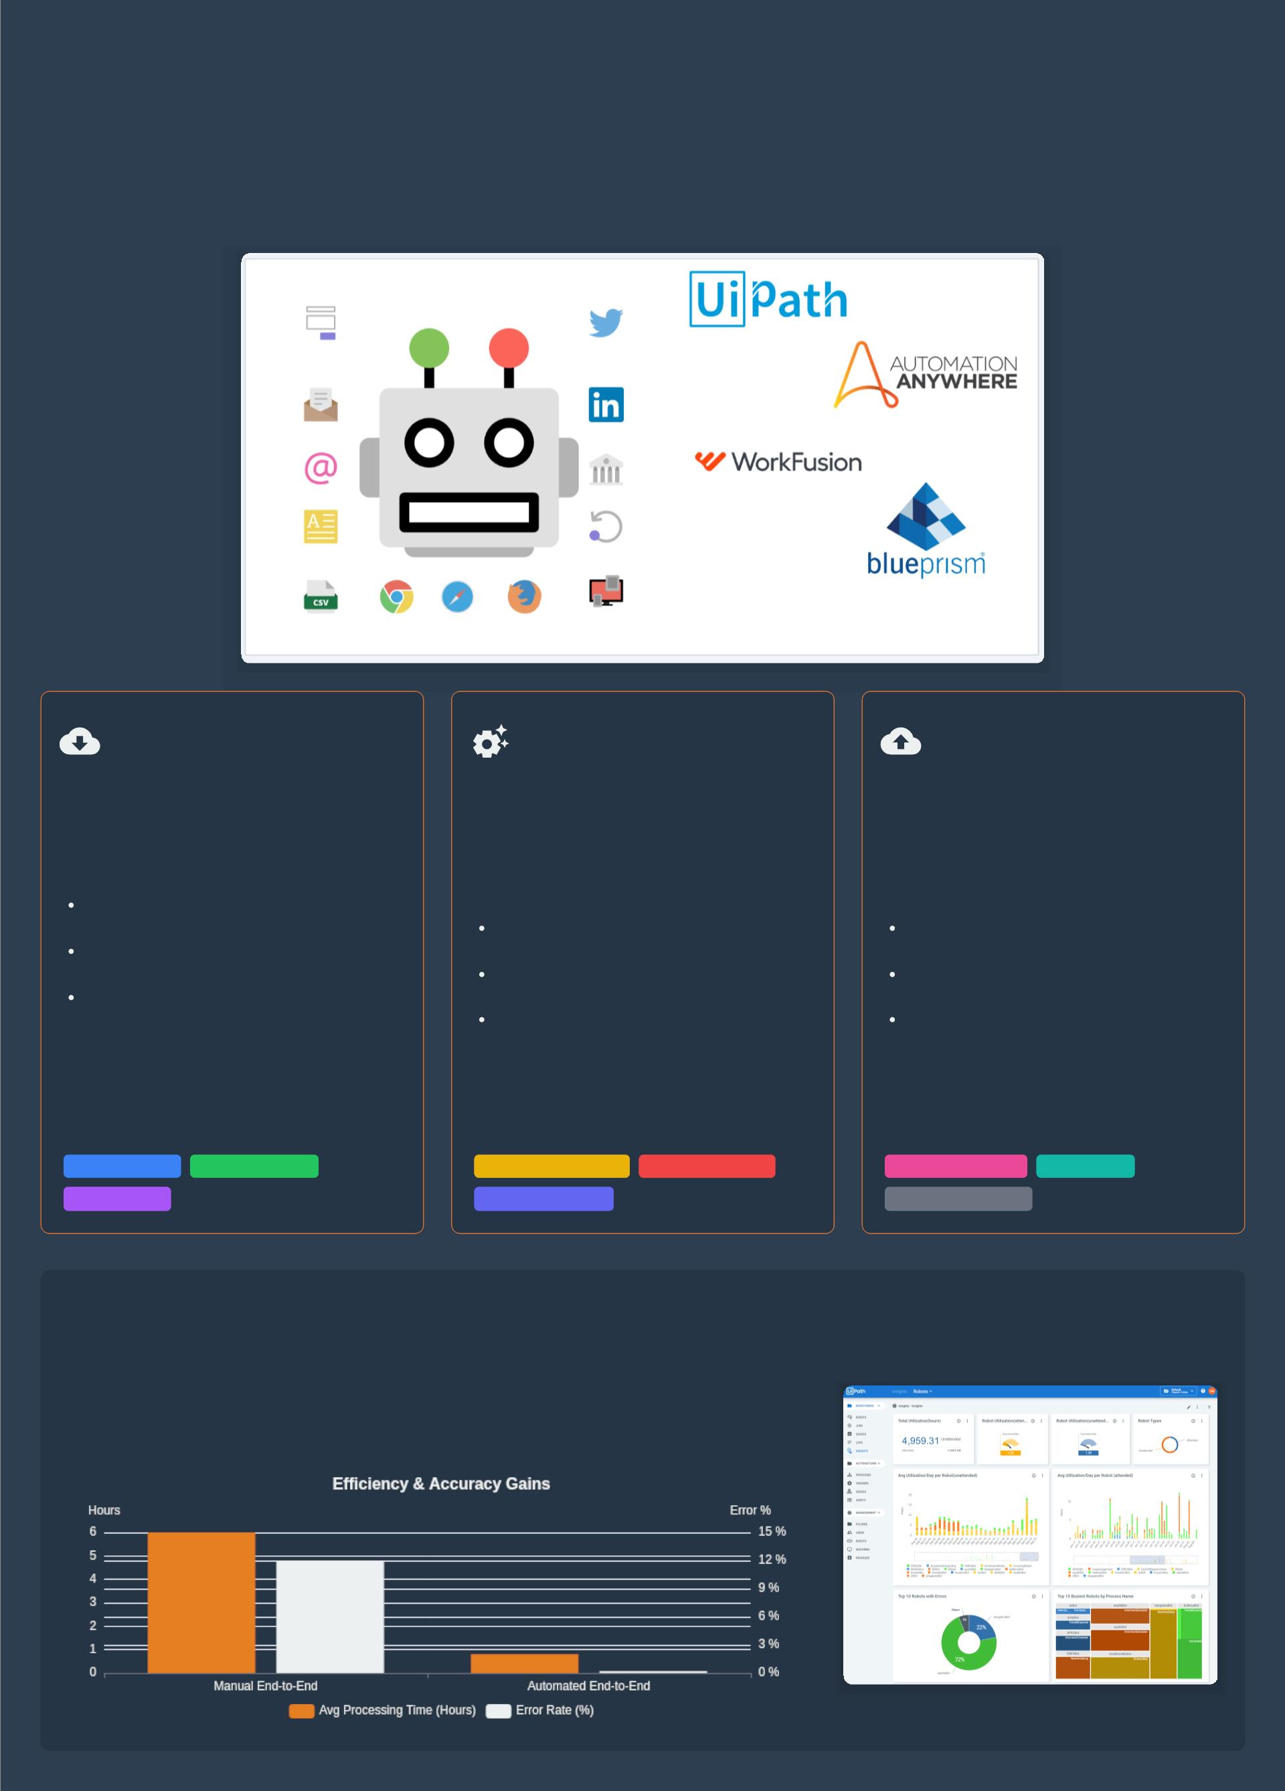
Combining Data Tables and File Operations
The Power of Integrated Data and File Automation
In RPA, the true power of automation is unleashed when structured data handling (via Data Tables) is
seamlessly integrated with robust ﬁle system operations. This combination enables end-to-end automation of
complex, data-driven business processes, from ingestion to ﬁnal report generation.
Ingesting Data: Files
to Data Tables
Transforming Data: In-
Memory Processing
Exporting Data: Data
Tables to Files
Purpose: Extracting structured data from
ﬁles (Excel, CSV) and loading it into an in-
memory DataTablefor uniform processing.
Purpose: Performing complex
transformations, ﬁltering, and aggregations
directly within the DataTablefor high-
speed computation.
Purpose: Exporting the processed
DataTablecontent back into various ﬁle
formats for distribution, archival, or
reporting.
Key UiPath Activities:
Read Range (Excel): Imports data
from .xlsx, .xls.
Read CSV: Eﬃciently reads CSV ﬁles
into a DataTable.
Table Extraction: Extracts data from
web pages or apps.
Key UiPath Activities:
Key UiPath Activities:
Filter Data Table: Selects subsets of
data.
Write Range (Excel): Outputs
DataTable to Excel.
Join Data Tables: Combines multiple
Data Tables.
For Each Row: Iterates for row-level
operations.
Write CSV: Exports content to a CSV
ﬁle.
Move/Copy File: Manages the lifecycle
of reports.
Beneﬁt: Converts diverse ﬁle formats into
a standardized, manipulable structure.
Beneﬁt: Enables rapid, ﬂexible data
manipulation without external
dependencies during processing.
Beneﬁt: Delivers actionable results in a
persistent format for human use or system
integration.
Data Ingestion
Cross-Format
Structured Input
Data Transformation
Dynamic Filtering
Report Generation
System Integration
Data Export
High Performance
Performance Impact: Automated Data Pipeline
The synergy between Data Tables and File Operations empowers organizations to
build highly eﬃcient and accurate data processing pipelines. This automation
signiﬁcantly reduces manual eﬀort, accelerates turnaround times, and minimizes
errors, leading to tangible operational beneﬁts.

Slide 9
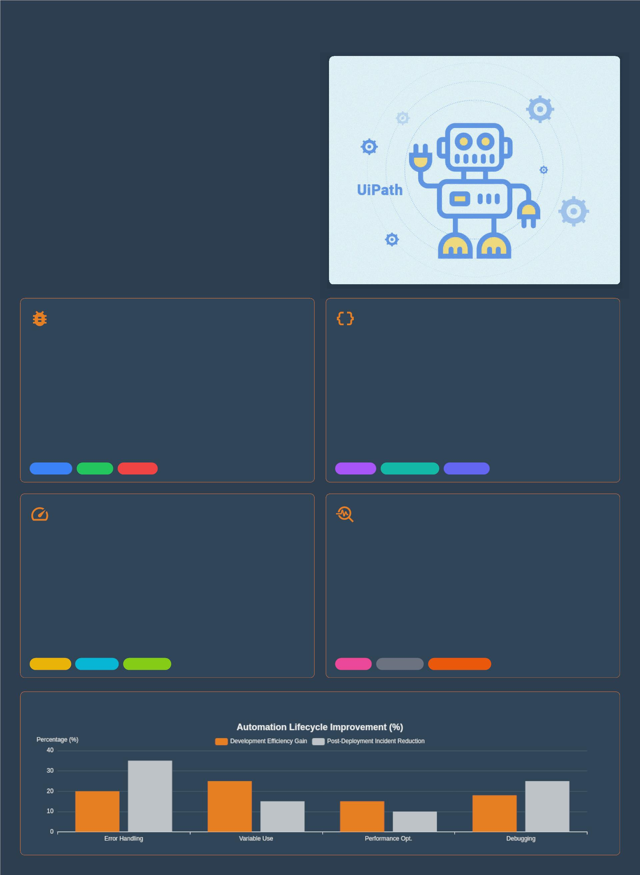
Best Practices and Troubleshooting Tips
Elevating Your Automation: Beyond
Basic Implementation
As automation complexity grows, adopting robust best practices
and mastering troubleshooting techniques becomes paramount.
These are critical for building resilient, high-performing, and
maintainable RPA solutions, especially when dealing with data
tables and ﬁle operations.
Proactive design choices and eﬀective debugging can
signiﬁcantly reduce development time, minimize post-
deployment incidents, and ensure the long-term success of your
automation initiatives.
Robust Error Handling
Strategic Variable Management
Anticipate & Isolate: Implement Try-Catch-Finallyblocks
around critical ﬁle and data table operations. Use speciﬁc exception
types (e.g., IOException,
Dynamic Paths: Avoid hardcoding ﬁle paths. Use variables and
combine them with Path.Combine. Use conﬁguration assets for
environment-speciﬁc paths.
System.Data.MissingPrimaryKeyException).
Data Table Variables: Declare variables of type
System.Data.DataTablefor structured data to leverage eﬃcient in-
memory manipulation methods.
Graceful Recovery: Deﬁne clear actions in 'Catch' blocks: retry
logic, send notiﬁcations, log errors, or move problematic ﬁles to an
error folder. 'Finally' ensures cleanup.
Scope & Naming: Use the smallest necessary scope and adopt
consistent naming conventions (e.g., in_FilePath,
dt_ProcessedRecords) to enhance readability.
Validation First: Use Path Existsto check for ﬁles. Validate
DataTable columns and data types before access to prevent runtime
errors.
Resiliency
Stability
Recovery
Flexibility
Maintainability
Readability
Optimizing for Large Datasets
Mastering Debugging
Batch Processing: For very large ﬁles, process data in smaller
chunks rather than loading the entire dataset into memory at once to
reduce memory footprint.
Breakpoints & Stepping: Use breakpoints to pause execution.
Employ Step Into(F11) to dive into activities and Step Over(F10)
to execute them as a whole.
In-Memory Operations: Perform transformations (ﬁltering, joining)
on the DataTablein memory using LINQ or dedicated activities for
signiﬁcant speed gains over ﬁle I/O.
Watch & Locals Panels: Monitor variable values in real-time using
the
Watchand Locals
panels to identify incorrect data
transformations or unexpected values.
Eﬃcient Reads/Writes: Use optimized activities like Read/Write
Rangefor Excel and Read/Write CSV. Minimize UI interactions during
data processing.
Logging & Tracing: Strategically place
Log Messageactivities (Info,
Warn, Error) to record process steps, variable values, and error
occurrences for post-execution analysis.
Eﬃciency
Scalability
Throughput
Analysis
Traceability
Problem Solving
Quantiﬁable Impact of Best Practices

